Slide 1

WELCOME TO STOKE DAMEREL
PRIMARY ACADEMY
Year 1
September 2024

Slide 2
STAFFING
The Year 1 classes are:
Camelot
Hamelin
Teacher: Megan Shaw
Teachers: Lucy Hodge &
Natalie Turnock
HLTA: Roz Luton
TA: Jackie Horsewell

Slide 3
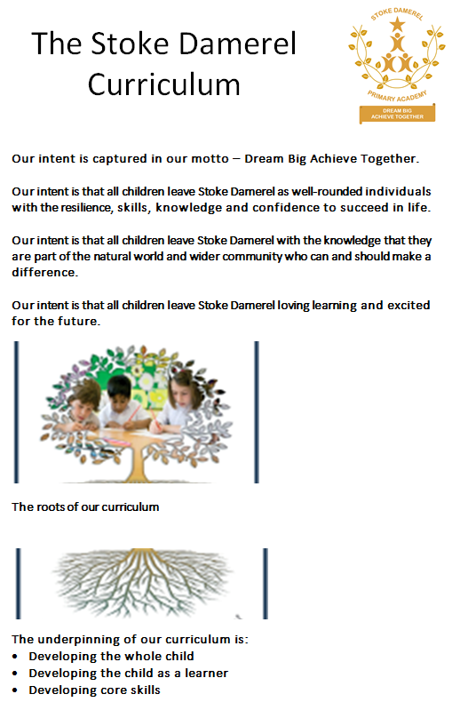

DEVELOPING SKILLS AND ATTITUDES
I can have a go
I enjoy challenge
I am curious about the world around me
I’ve got my own ideas that I’d like to try
I can keep trying until I can do it
I can understand how others feel

Slide 4

How we support learning in Reading
Daily reading and phonics through Read Write Inc.
Sharing whole class books
Setting an example as staff who love reading!
How you can support learning in Reading
Listen to your child read and talk about the books they are reading
Encourage them to read a little EVERY DAY!!!
Please record in the reading record – your child will want to collect stars for their bookmark and send it to school daily
We will change reading books every 3 or 5 days (depending which RWI level your child is on)
Your child will bring home a RWI storybook (which they will be reading in school), a Book Bag Book (which links to their RWI storybook) and a reading for pleasure book (this is for you to share, your child is not expected to read this independently).

Slide 5
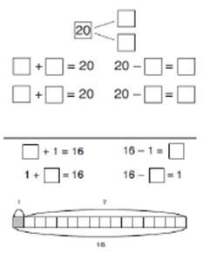
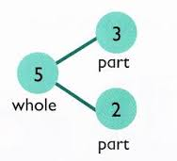
How we support learning in Mathematics
Daily maths and mental arithmetic lessons.
Focus on understanding by teaching with the
concrete (objects), pictorial (pictures), abstract (written) method
How you can support learning in Mathematics
Look at maths opportunities in the real world – money, time, measures …
Notes:
Link to Website – Curriculum – Maths calculation strategy guidance.

Slide 6

How we support learning in Writing
Engaging with talk, drama and creative tasks
High quality books
Modelling good writing practices
Giving the children purpose for their writing
Supporting grammar, spelling and punctuation learning
How you can support learning in Writing
Support spelling homework – These will be given to your child on a Friday and should be completed by the following Thursday.
Encourage pencil grip, good seating and writing at home e.g. thank you letters after a birthday

Slide 7
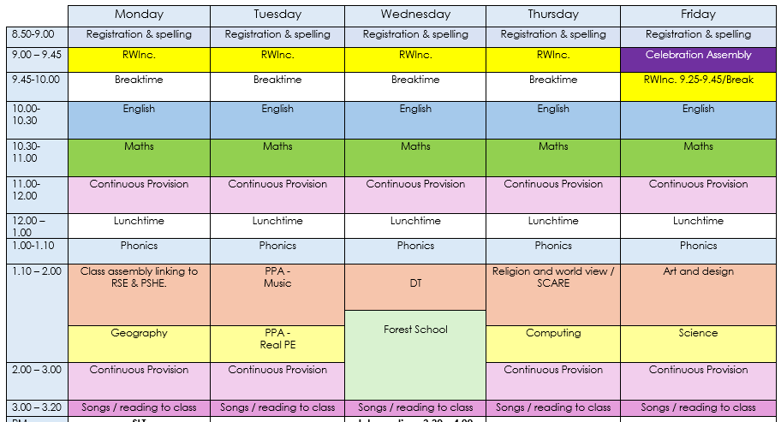
Day to day

Slide 8

Assessments
Phonics Screening Check – June
Termly in school assessments (Writing & Maths). We will contact you throughout the year to share your children’s results and advice on how to help your child at home.

Slide 9

Enrichment Opportunities
Ks1 Performance (Easter term)
At least 1 off site trip over the year
Weekly forest school

Slide 10
Forest School and PE
We have forest school sessions every Wednesday afternoon. During these sessions the children will learn some forest school skills (e.g. knot tying) as well have chance to experience nature throughout the year.
We also teach some of our foundation subjects outside during forest school sessions.
PE will be taught every Tuesday afternoon by our PE coaches.
We also ensure the children have further opportunities for physical development throughout their day.
Please ensure children are dressed appropriately for both PE and forest school days.

Slide 11


Rewards
Reading stars
Class dojo
Golden tickets (traffic light system)
Star of the Week
Superstar Cup

Slide 12
How to contact your child’s teacher
If you need to ask a question or inform your child’s teacher about something, please email your child’s teacher directly. Our email addresses can be found on the website.
If you need to get a message to the class teacher during the school day – Eg: changing the person collecting your child from school - please contact the school office.
(Please avoid ringing between 8:30 and 9:30 am, as this is their busiest time.)
Lucy.hodge@stokedamerelacademy.org
Megan.shaw@stokedamerelacademy.org
Natalie.turnock@stokedamerelprimaryacademy.org

Slide 13

How to help at home
School readiness – good bedtime routine, healthy breakfast, calm journey to school, arrive at school on time.
Children will need:
  a water bottle (no juice or squash please!)
  their reading books
  a coat (we will go outside when it rains)
Homework:
Spelling
Daily reading

Slide 14

Thank you for coming ☺
Any questions?

